Slide 1
Animation Movie Analysis
BY
Keerthi

Slide 2
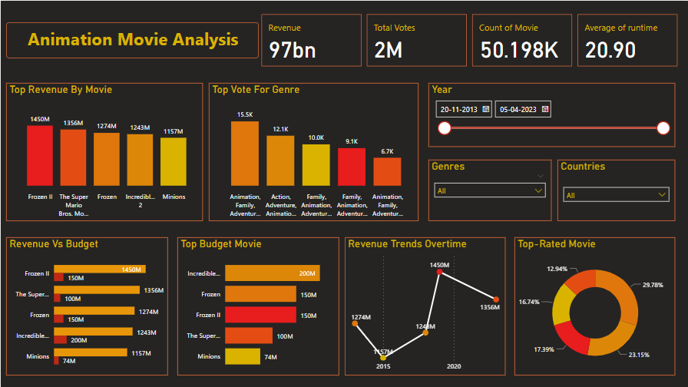

Slide 3
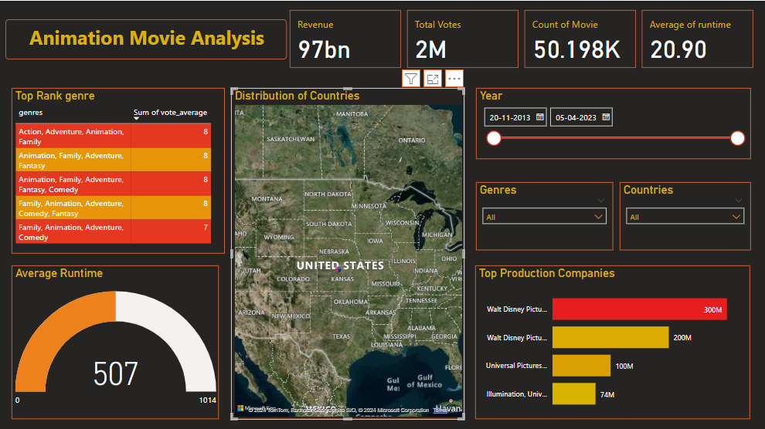

Slide 4

THANK YOU

